Slide 1




Supporting Ranking and Clustering as Generalized Order-By and Group-By
Chengkai Li (UIUC)
joint work with
Min Wang Lipyeow Lim Haixun Wang (IBM)
Kevin Chang (UIUC)

Slide 2
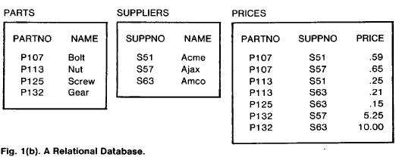
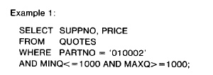
Boolean database queries
(Relational Algebra and System R papers)

Slide 3
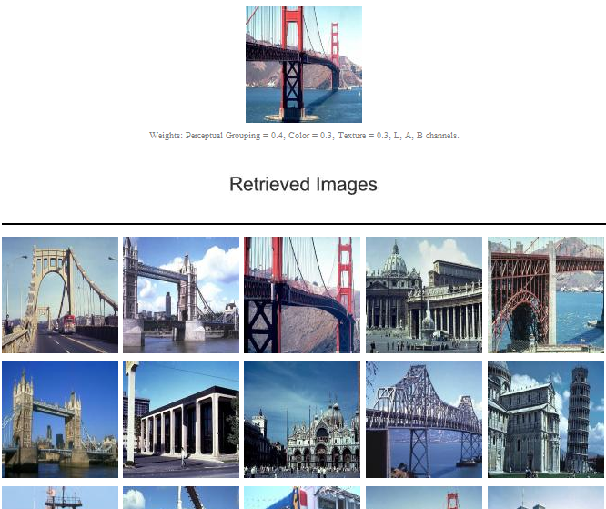
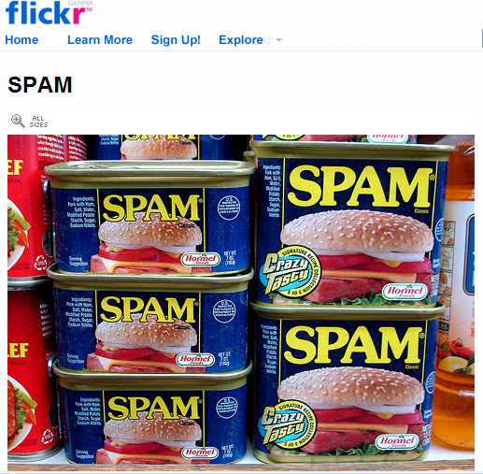
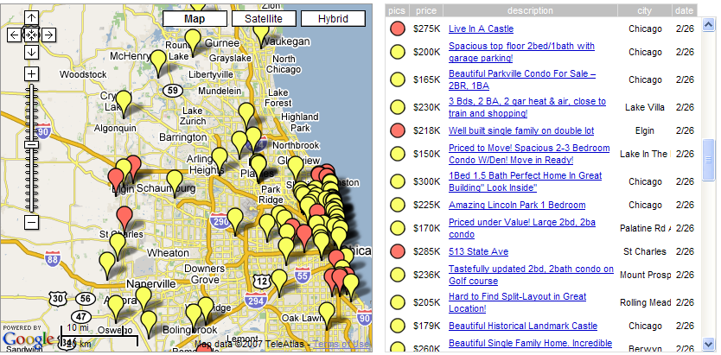

Data Retrieval

Slide 4
Example: What Boolean queries provide
  SELECT *
FROM Houses H
WHERE 200K<price<400K AND #bedroom = 4
 | query semantics | results organization
Boolean query | hard constraints (True or False) | a flat table too many (few) answers

Slide 5
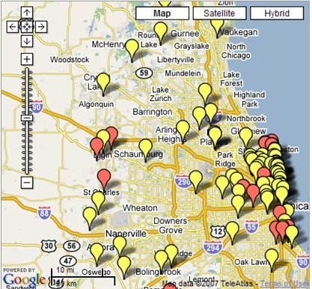
Example: What may be desirable
< 500K is more acceptable
but willing to pay more for big house
close to the lake is a plus
avoid locations near airport
…
 | query semantics | results organization
Boolean query | hard constraints (True or False) | a flat table too many (few) answers
fuzzy retrieval | “soft” constraints (preference,similarity,relevance,…) | a ranked list a grouping of results etc.

Slide 6







“Retrieval” of DATA:
From Boolean query to fuzzy retrieval
retrieval engine
data
text
search engine

Slide 7
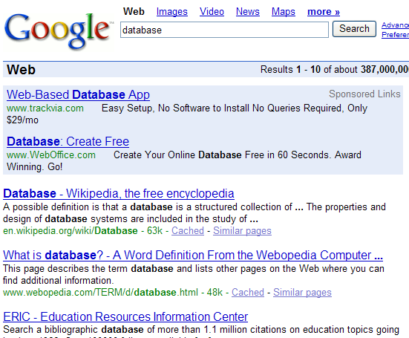
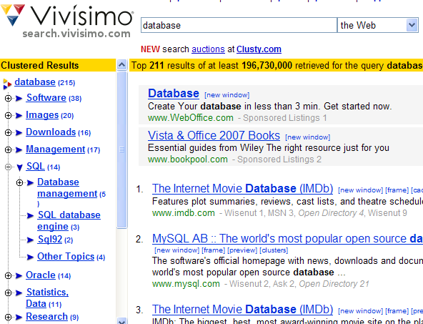

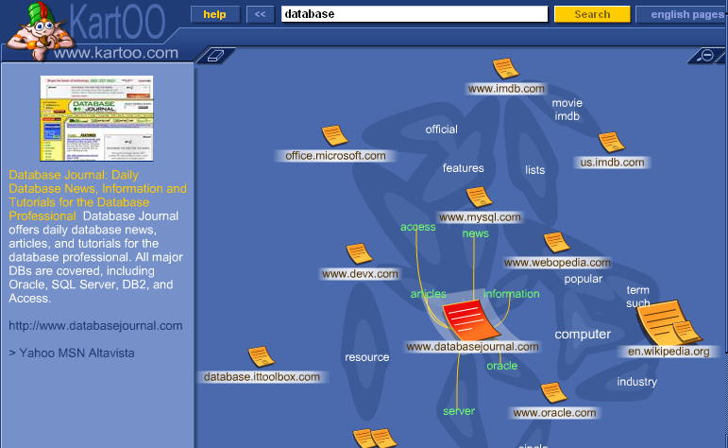
Retrieval mechanisms: Learning from Web search
Ranking
Clustering
Navigation Map
Facets
Categorization
…

Slide 8
Generalizing SQL constructs for data retrieval
Order-By
Group-By

Slide 9
From crispy ordering to fuzzy ranking
Crispy ordering
Order By
Houses.size, Houses.price
  by attribute values
  equality of values
  order ≠ desirability
Fuzzy ranking
Order By
Houses.size − 4*Houses.price
  Limit
  5
  by ranking function
  combine matching criteria
  order => desirability : top-k

Slide 10
From crispy grouping to fuzzy clustering
Crispy grouping
Group By
Houses.size, Houses.price
  by attribute values
  equality partition
  no limit on output size
Fuzzy clustering
Group By
k-means(H.size, H.price)
  Into
  5
  by distance function
  proximity of values
  number of clusters

Slide 11
Need for combining ranking with clustering
Clustering-only
  A group can be big
    “too many answers” problem persists
  How to compare things within each group?
Ranking-only
  Lack of global view
  top-k results may come from same underlying group
  (e.g., cheap and big houses come from a less nice area.)
  Different groups may not be comparable

Slide 12
Contributions
Concepts
  generalize Group-By to fuzzy clustering, parallel to the generalization from Order-By to ranking
  integrate ranking with clustering in database queries
Efficient processing framework
  summary-based approach

Slide 13
Related works
Clustering
  not on dynamic query results
  use summary (grid with buckets)
  (e.g., STING [WangYM97] WaveCluster [SheikholeslamiCZ98] )
Ranking (top-k) in DB: many instances (e.g., [LiCIS05])
  use summary (histogram) in top-k to range query translation [ ChaudhuriG99]
Categorization of query results [ChakrabartiCH04]
  different from clustering
  no integration with ranking
  focus on reducing navigation overhead, not processing
Web search and IR (e.g., [ZamirE99] [LeuskiA00])

Slide 14
Integrate the two generalizations
Boolean conditions
Ranking
Clustering
?
semantics
evaluation

Slide 15
Query semantics: ClusterRank queries
SELECT *
FROM Houses
WHERE area=“Chicago”
GROUP BY longitude, latitude INTO 5
ORDER BY size – 4*price LIMIT 3
Boolean
clustering
ranking
Semantics: order-within-groups
Return the top k tuples within each group (cluster).

Slide 16
Several notes
Non-deterministic semantics
  clustering is non-deterministic by nature
  sacrificing the crispiness of SQL queries
  worthy for exploring the fuzziness in data retrieval?
Language syntax isn’t our focus
  current SQL semantics: order-among-groups
  Select… From… Where…Group By… Order By…(RankAgg[LiCI06])
  OLAP function
Clustering function
  algorithm, distance measure hidden behind
Other semantics
  e.g., cluster the global top k

Slide 17
Query evaluation:
Straightforward Materialize-Cluster-Sort approach
SELECT *
FROM Houses
WHERE area=“Chicago”
GROUP BY longitude, latitude INTO 5
ORDER BY size – 4*price LIMIT 3
Boolean
clustering
sorting

Slide 18
Query evaluation:
Straightforward Materialize-Cluster-Sort approach
Overkill:
cluster and rank all,
only top 10 in each cluster are requested
Inefficient:
  fully generate Boolean results
  clustering large amount of results is expensive
  sorting big group is costly
Boolean
clustering
sorting

Slide 19
Query evaluation:
Summary-driven approach
use summary to cluster
use summary for pruning in ranking
use bitmap-index
  to construct query-dependant summary
  to bring together Boolean, clustering, and ranking

Slide 20
Summary for clustering
1
2
longitude
longitude
2
4
2
5
1
2
latitude
latitude
✗
✓
K-means
on original tuples
weighted K-means
on virtual tuples

Slide 21
Summary for ranking
0
0
2
1
1
(0,20]
(10,30]
(20,40]
- 4*price
-10
-10
- 4*price
2
1
(0,20]
(10,30]
-20
-20
1
[ -40,10]
(0,20]
-30
-30
-40
-40
0
10
20
30
40
0
10
20
30
40
size
size
ORDER BY size – 4 *price
LIMIT 3

Slide 22
Construct summary by bitmap-index
0
TID
t1
t2
t3
t4
t5
…
size(10,20]
0
1
0
0
1
…
-4*price[-40,-30]
1
1
0
1
0
…
&
0
1
0
0
0
…
- 4*price
t1
t3
-10
t4
-20
-30
t2
t5
-40
0
10
20
30
40
size
The advantages of using bitmap index:
Small
Bit operations (&, |, ~, count) are fast
Easily integrate Boolean, clustering, and ranking

Slide 23
Integrating Boolean, clustering, and ranking
longitude
- 4*price
Vec(area=“chicago”)
00111111…
latitude
&
&
size
longitude
40
- 4*price
30
20
10
latitude
0
10
20
30
40
size
Vec(cluster1)
&
longitude
00101001…
40
1
2
- 4*price
30
2
4
2
5
20
1
2
Vec(cluster2)
10
latitude
00010110…
0
10
20
30
40
size

Slide 24
Experiments
ClusterRank (summary-driven approach) vs. StraightFwd (materialize-cluster-rank)
  Processing efficiency: ClusterRank >> StrightFwd
  Clustering Quality: ClusterRank ≈ StrightFwd
synthetic data
various configuration parameters
(#tuples, #clusters, #clustering attr, #ranking attr, #paritions per attr, k)

Slide 25
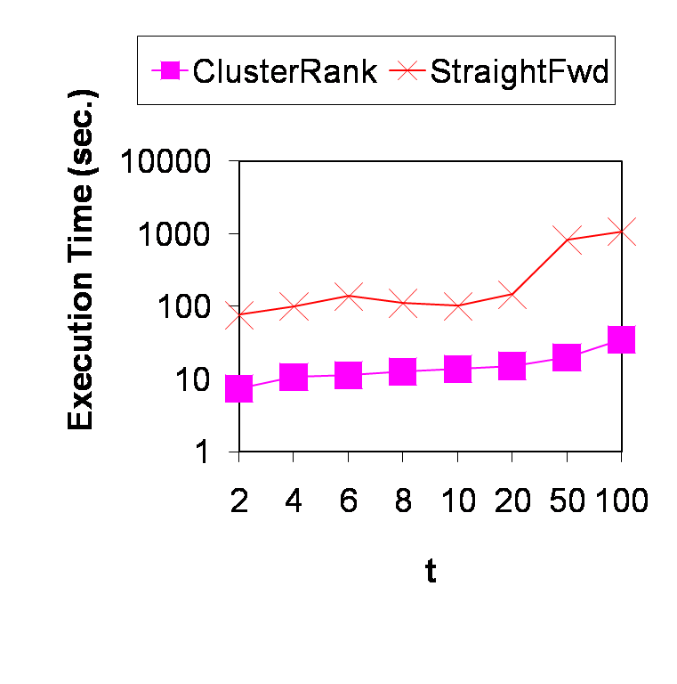
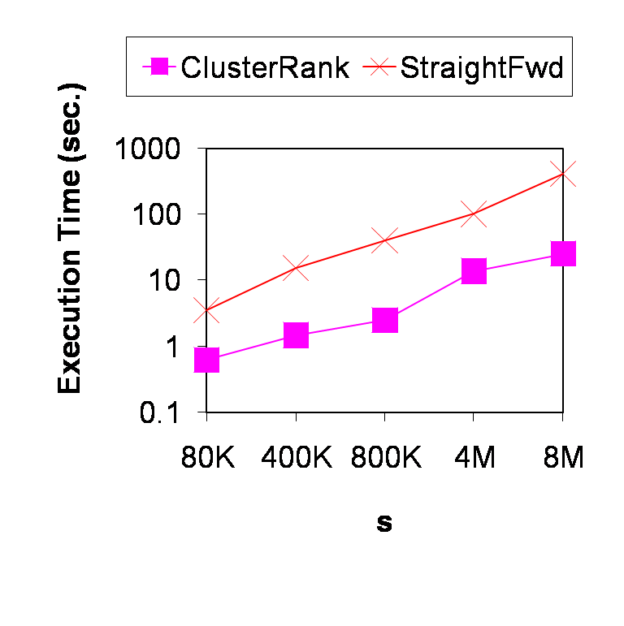
Efficiency
t: #clusters
4M tuples, 5 clustering attr,
3 ranking attr, top 5
s: #tuples
10 clusters, 5 clustering attr,
3 ranking attr, top 5

Slide 26
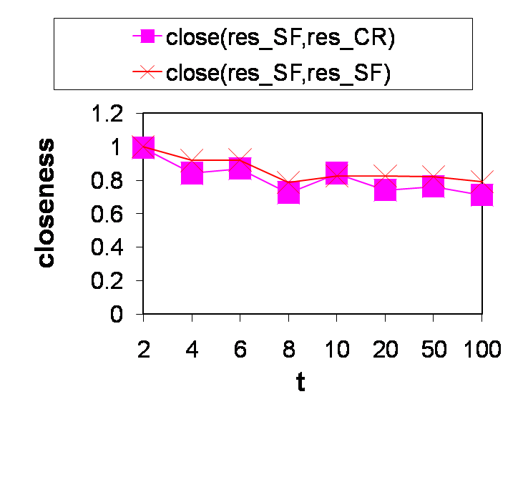
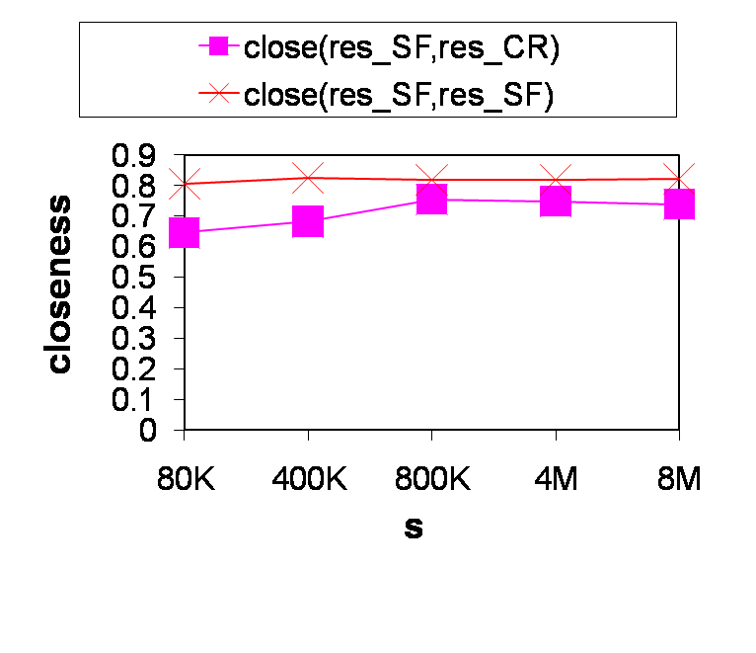
Clustering quality
close(res_SF, res_CR): closeness of results from StraightFwd and ClusterRank
close(res_SF, res_SF): closeness of results from different runs of StraightFwd
t: #clusters
4M tuples, 8 clustering attr
s: #tuples
10 clusters, 3 clustering attr

Slide 27
Conclusions
Borrow innovative mechanisms from other areas to support data retrieval applications
Ranking and clustering as generalized Order-By and Group-By, integrated in database queries
Query semantics: ClusterRank queries
Query evaluation: summary-driven approch vs. materialize-cluster-sort
  evaluation efficiency: ClusterRank >> StraightFwd
  clustering quality: ClusterRank ≈ StraightFwd

Slide 28
Acknowledgement
Rishi Rakesh Sinha: source code of bitmap index
Jiawei Han: discussions regarding presentation

Slide 30
Alternative semantics?
global clustering / local ranking (focus of this paper)
clustering: Boolean results
ranking: local top k in each cluster
local clustering / global ranking
clustering: global top k
ranking: Boolean results
global clustering / global ranking
clustering: Boolean results
ranking: in each cluster, return those belonging to global top k
rank the clusters? (by average of local top k?)

Slide 31
Join queries
Star-schema
fact table, dimension tables, key and foreign key
Bitmap join-index
index the fact table by the attributes in dimension tables

